Slide 1

Computer Vision and Generative Visual AI Workloads Algorithms and Deployment Challenges Activities Report December 2025
Ruben Tous
Associate Professor. Computer Architecture Department
Universitat Politecnica de Catalunya (UPC)
CROMAI
Computational Resources Orchestration
and Management for AI

Slide 2
Introduction
BIMAI (Barcelona Image and Artificial Intelligence Lab)
AI, Computer Vision and image/video synthesis
Focus on visual arts
Algorithms
Emphasis on non-mainstream creative flows (e.g. traditional 2D animation, educational materials, indie videogames, etc.)
Computational performance
AI inference workflows and deployment on commodity hardware

Slide 3
#video-to-animation #video-to-video #rotoscoping

Slide 4
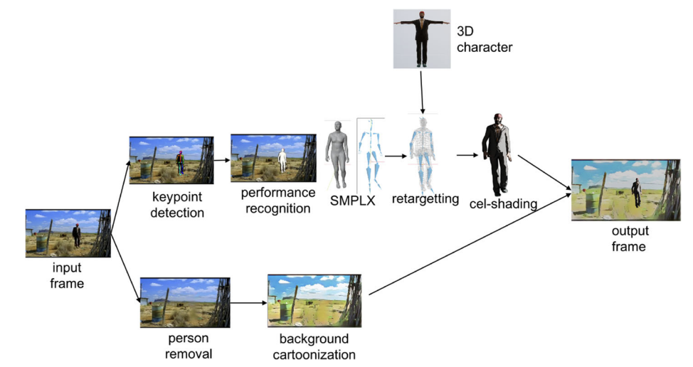
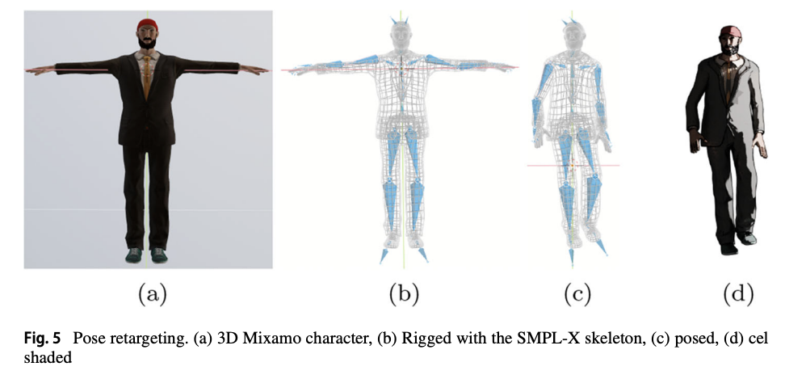
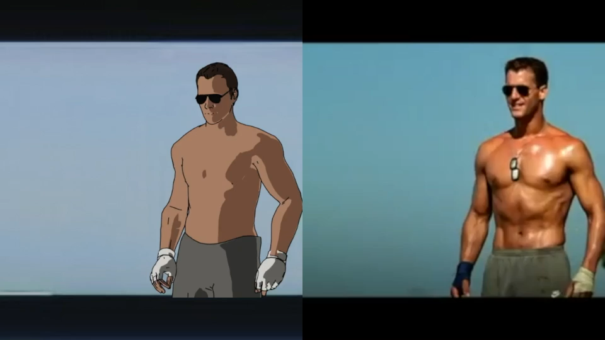
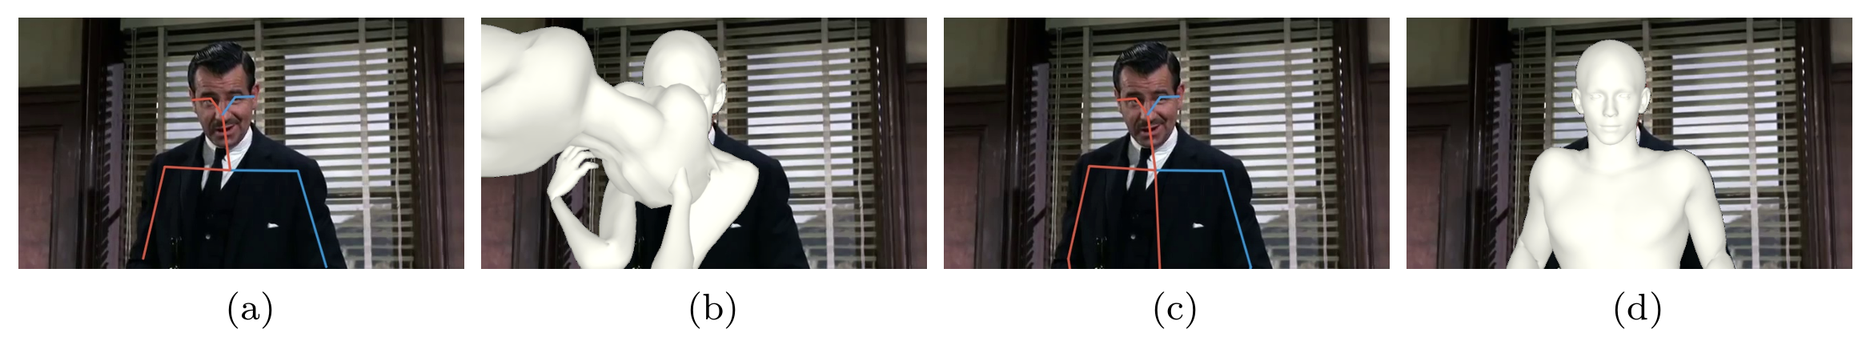
Rotoscoping through 3D Human Pose Estimation
[1] Ruben Tous. Pictonaut: Movie Cartoonization Using 3D Human Pose Estimation and GANs. Multimedia Tools and Applications volume 82, pag. 21101–21115 (2023). 2023
[2] Ruben Tous, Jordi Nin and Laura Igual. Human Pose Completion in Partial Body Camera Shots. Journal Of Experimental & Theoretical Artificial Intelligence. July 2023.
[3] Beatriz Gomes, Ruben Tous. A 3D Pipeline for 2D Pixel Art Animation. 2023

Slide 5
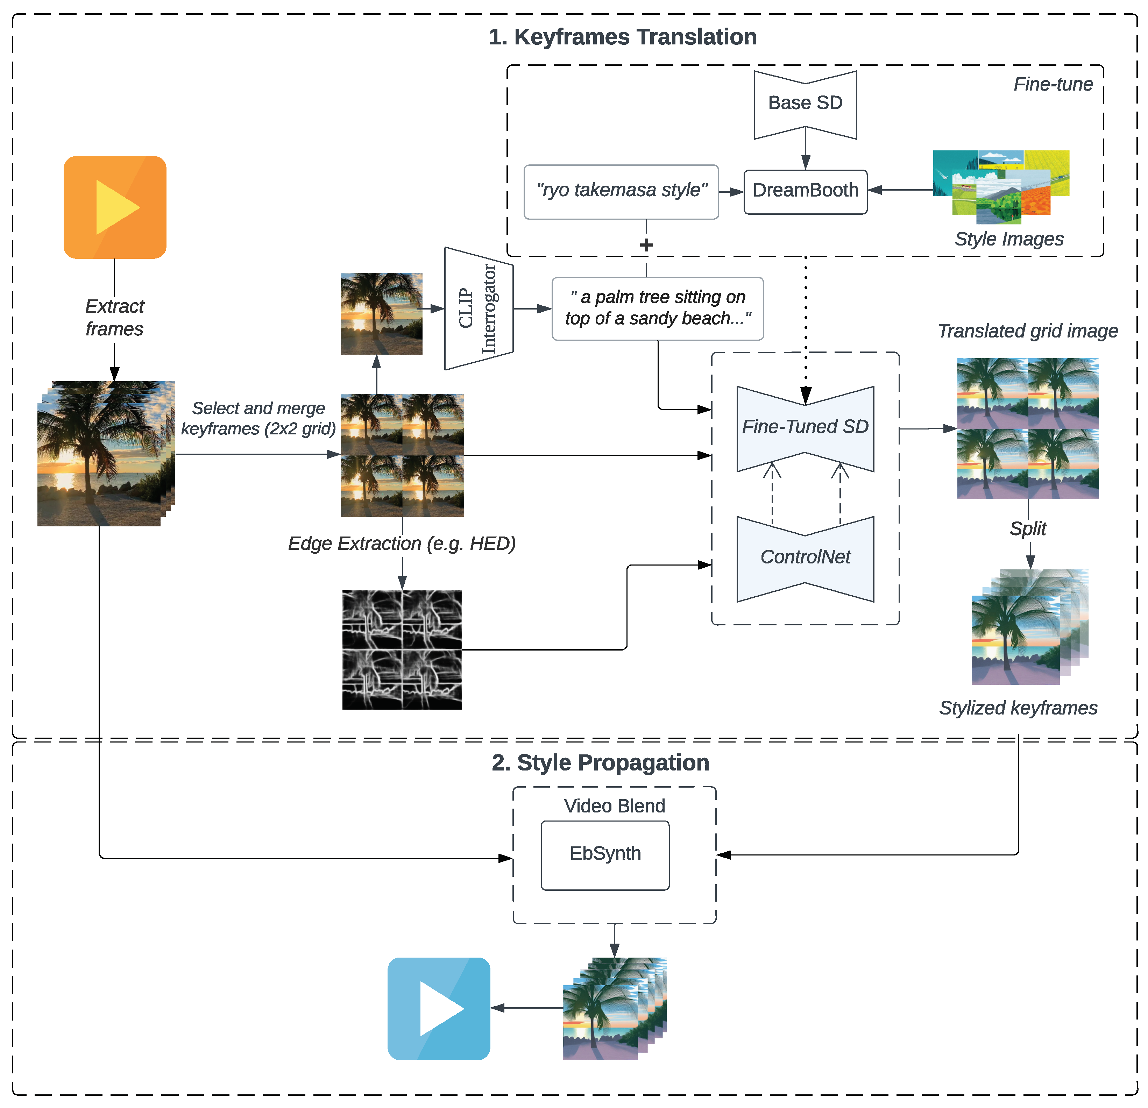
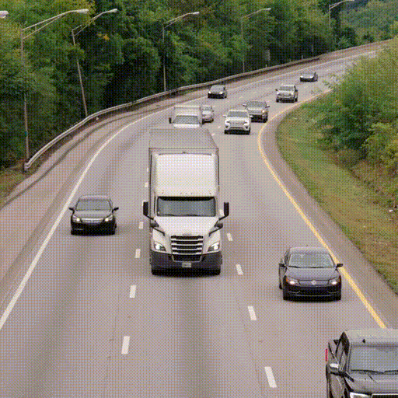
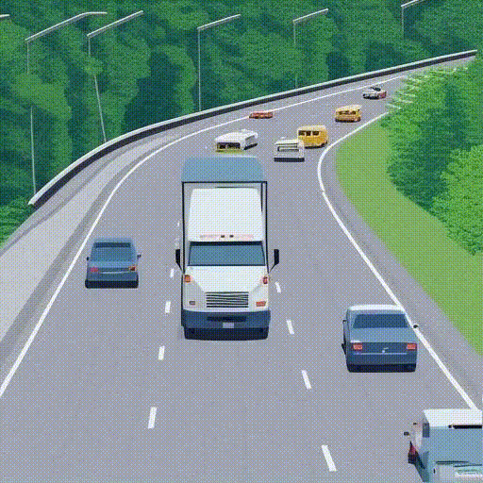
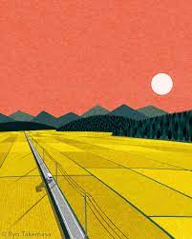
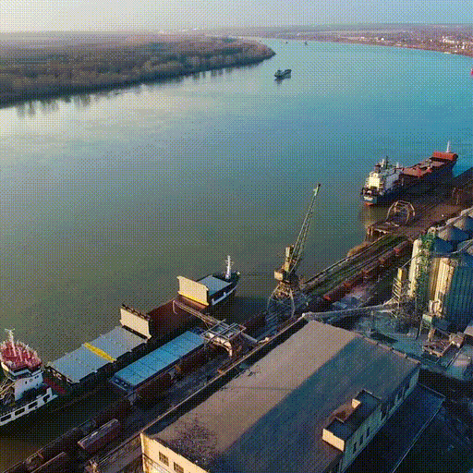
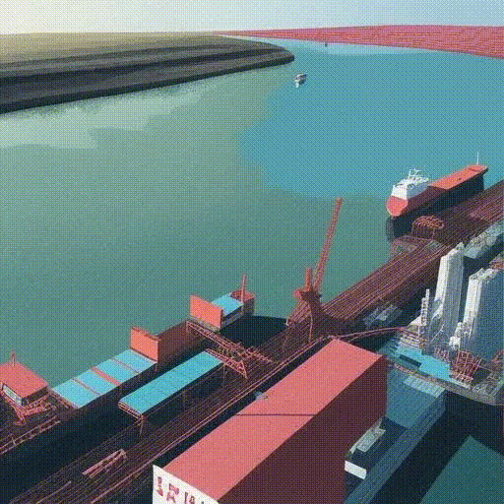
Temporally Coherent Video Cartoonization for Animation Scenery Generation
Sunset Over the Rice Fields
Ryo Takemasa
Demos: https://github.com/gustavorayo/video-to-cartoon
[4] Gustavo Rayo and Ruben Tous. Temporally Coherent Video Cartoonization for Animation Scenery Generation. Electronics, 13(17), 3462. 2024

Slide 6
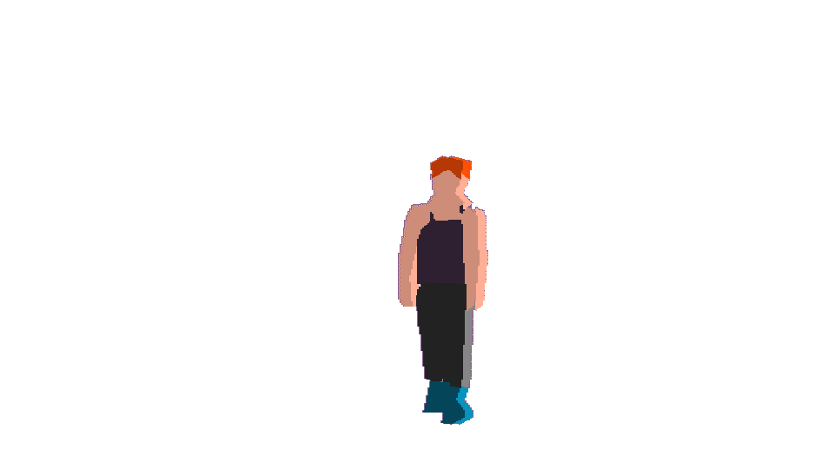
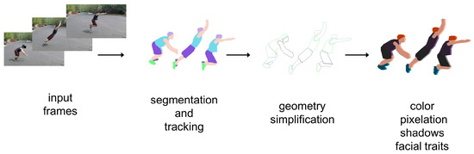
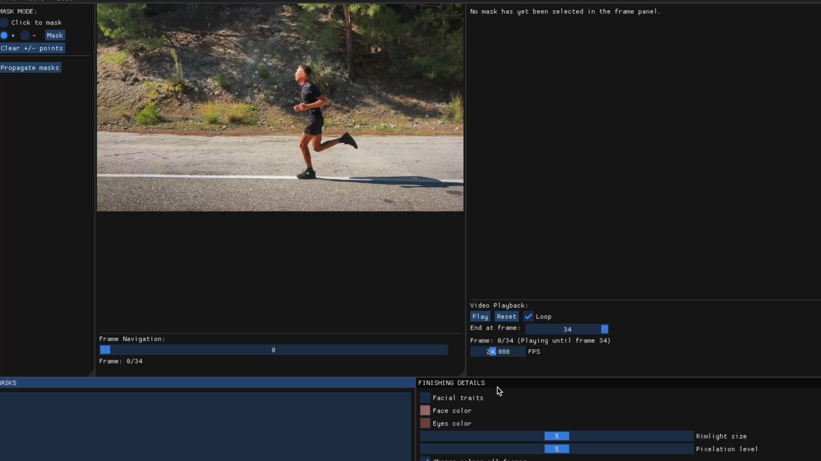
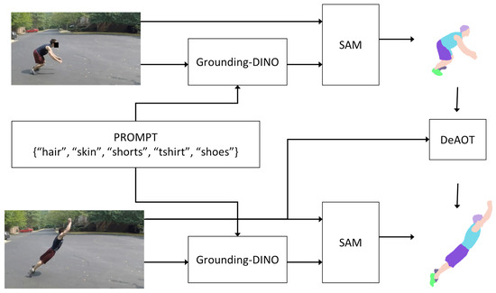
Lester: Rotoscope Animation Through Video Object Segmentation and Tracking
Project page: https://github.com/rtous/lester
[5] Ruben Tous. Lester: Rotoscope Animation through Video Object Segmentation and Tracking. Algorithms 17, no. 8: 330. 2024

Slide 7
#line-art #colorization #interpolation #superresolution #2D

Slide 8

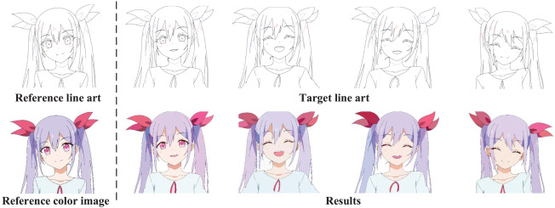


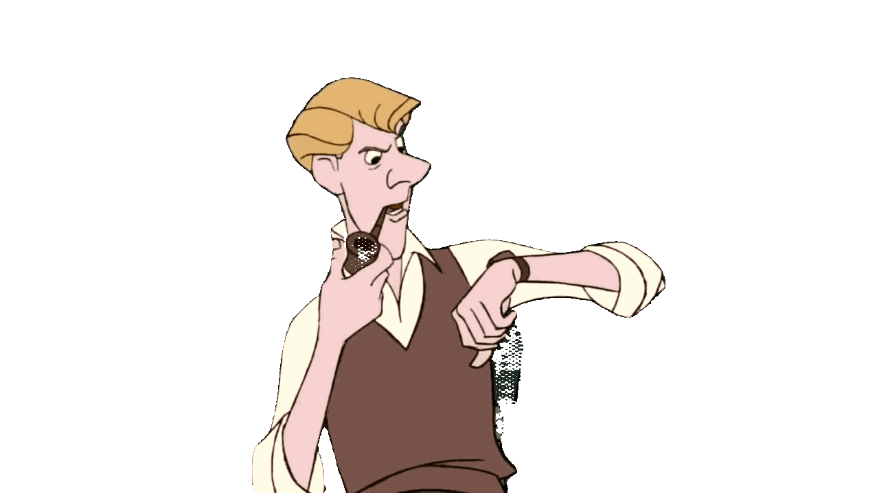
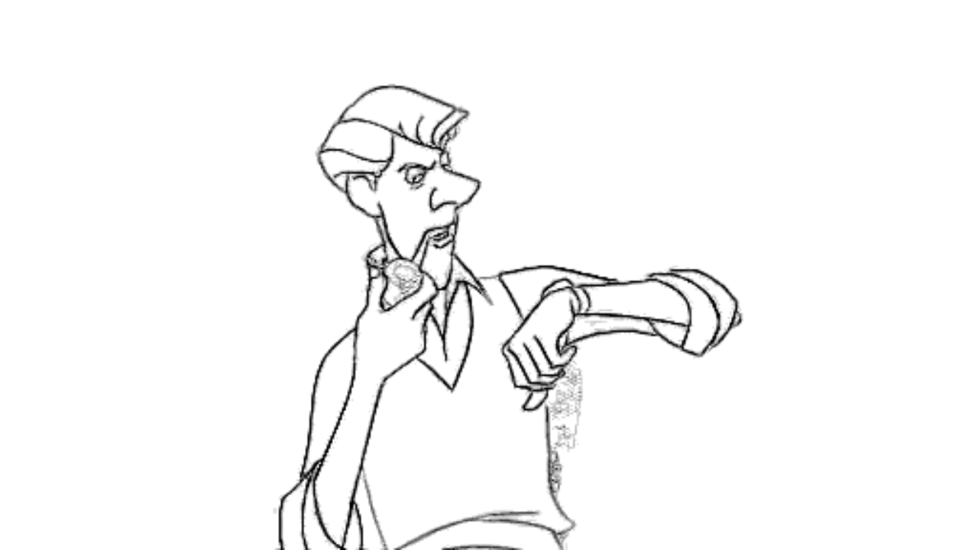
2D Animation In-betweening
in colaboration with
Reference-based animation line-art colirization
Lack of groundtruth data
Typically projections of 3D clips
Novel line-art extraction method combining:
Super-resolution
Video segmentation
[6] Judith Caldés, Ruben Tous, Beatriz Otero. Quality Assessment of State-of-the-Art 2D Animation Interpolation. Technical report. 2024
[7] Maria Bertolin, Ruben Tous. Reference-based Animation Line-Art Colorization. Technical report. 2025
[8] Rosa Ceano , Ruben Tous. Automatic Line Art Extraction from 2D Color Cartoons and Animations. Technical report. 2025

Slide 9
#efficiency #edge #interpretability

Slide 10
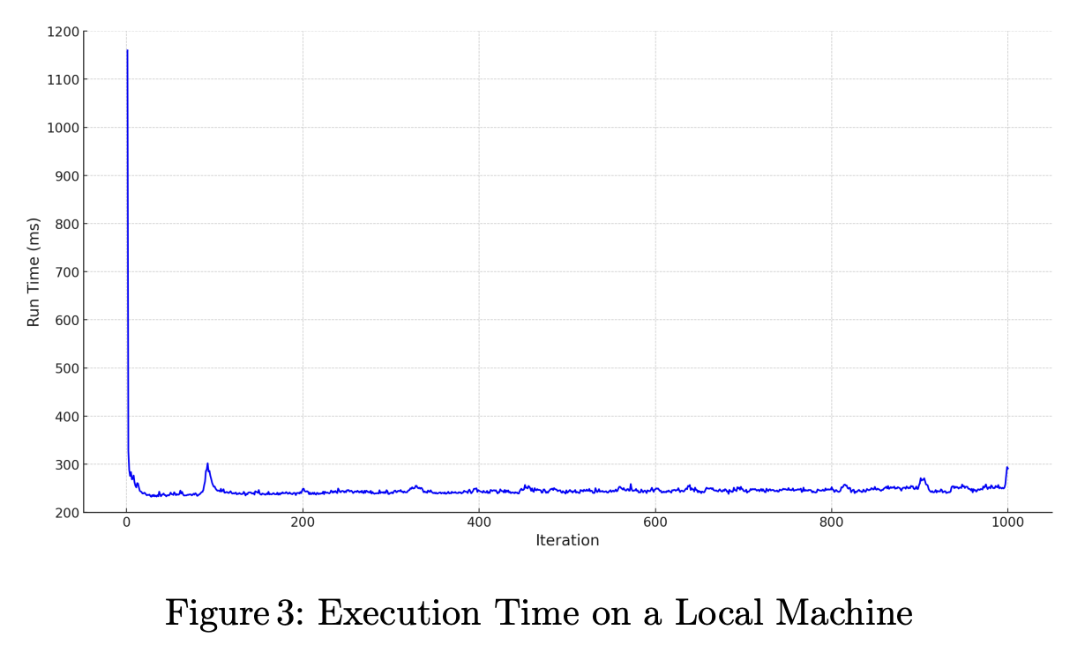
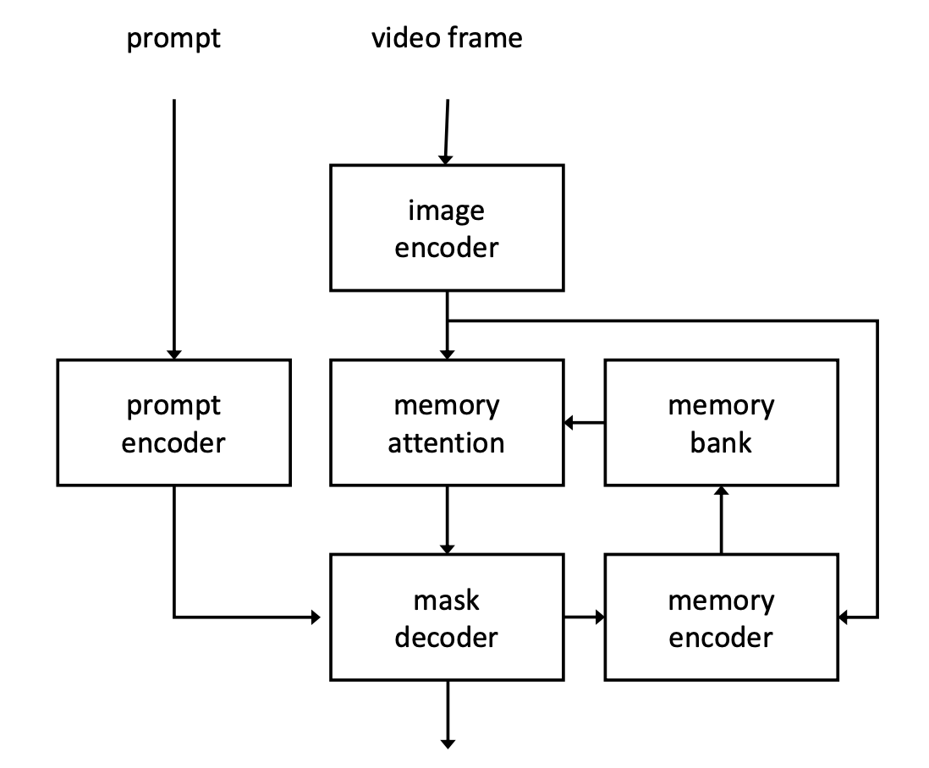
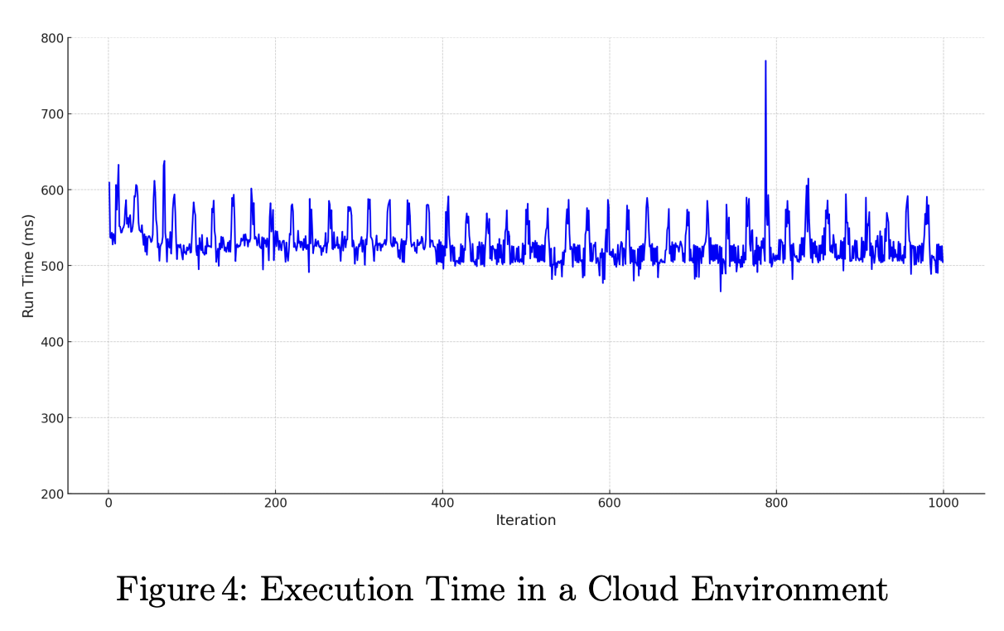
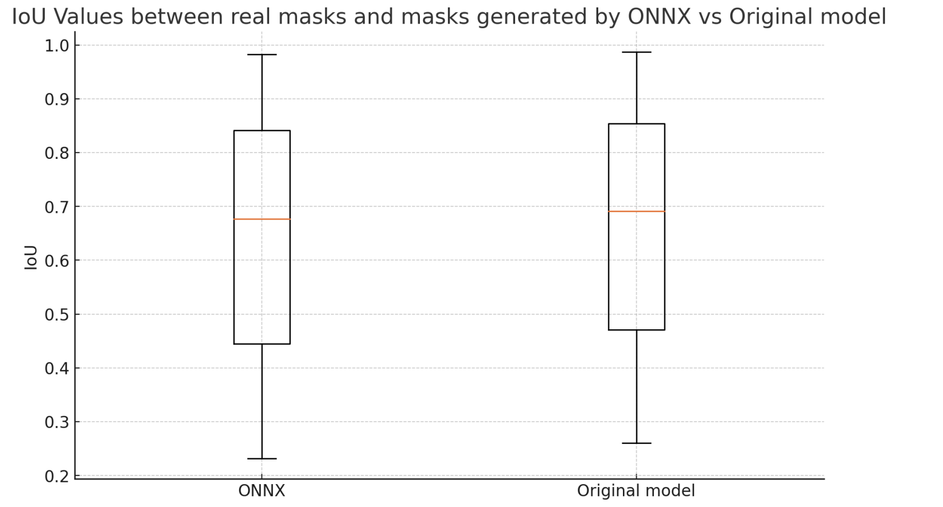
Deploying Vision Foundation AI Models on the Edge. The SAM2 Experience
Segmentation Anything Model 2 (SAM2)
Released by Meta on summer 2024
Promptable video segmentation
SAM2 Migration to C++
6 ONNX models
3000 lines of pipeline Python code
Performance evaluation
Comparison with cloud depl.
Accuracy evaluation
[9] Zheshuo Lin, Ruben Tous and Beatriz Otero. Deploying Vision Foundation AI Models on the Edge. The SAM2 Experience. Proceedings of the 18th International Work-Conference on Artificial Neural Networks (IWANN 2025). A Coruna, Spain, June 16-18, 2025.

Slide 11
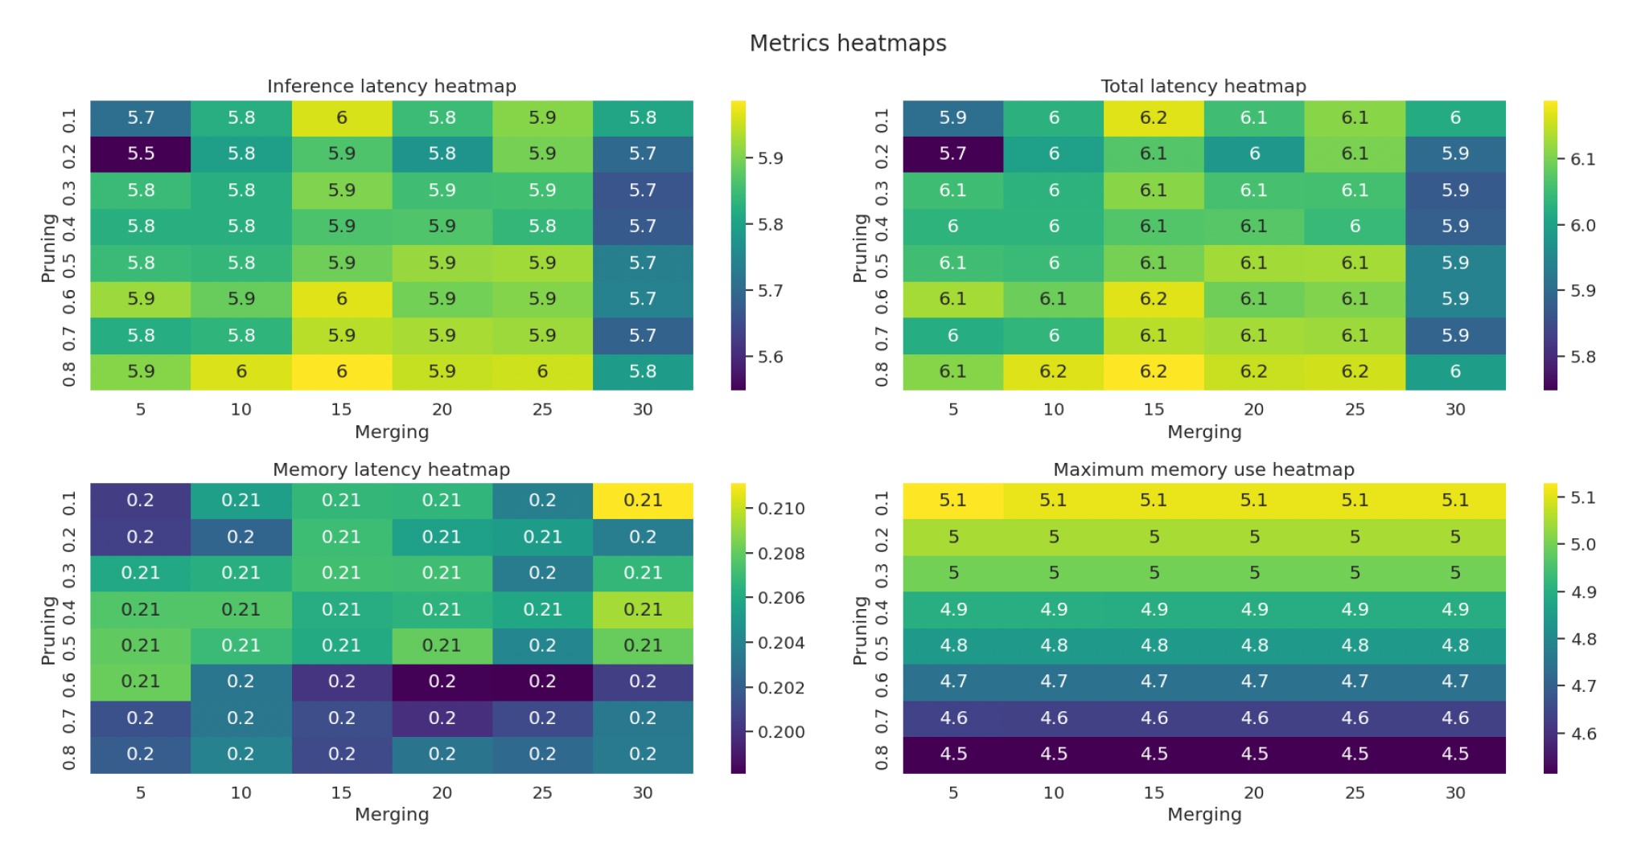
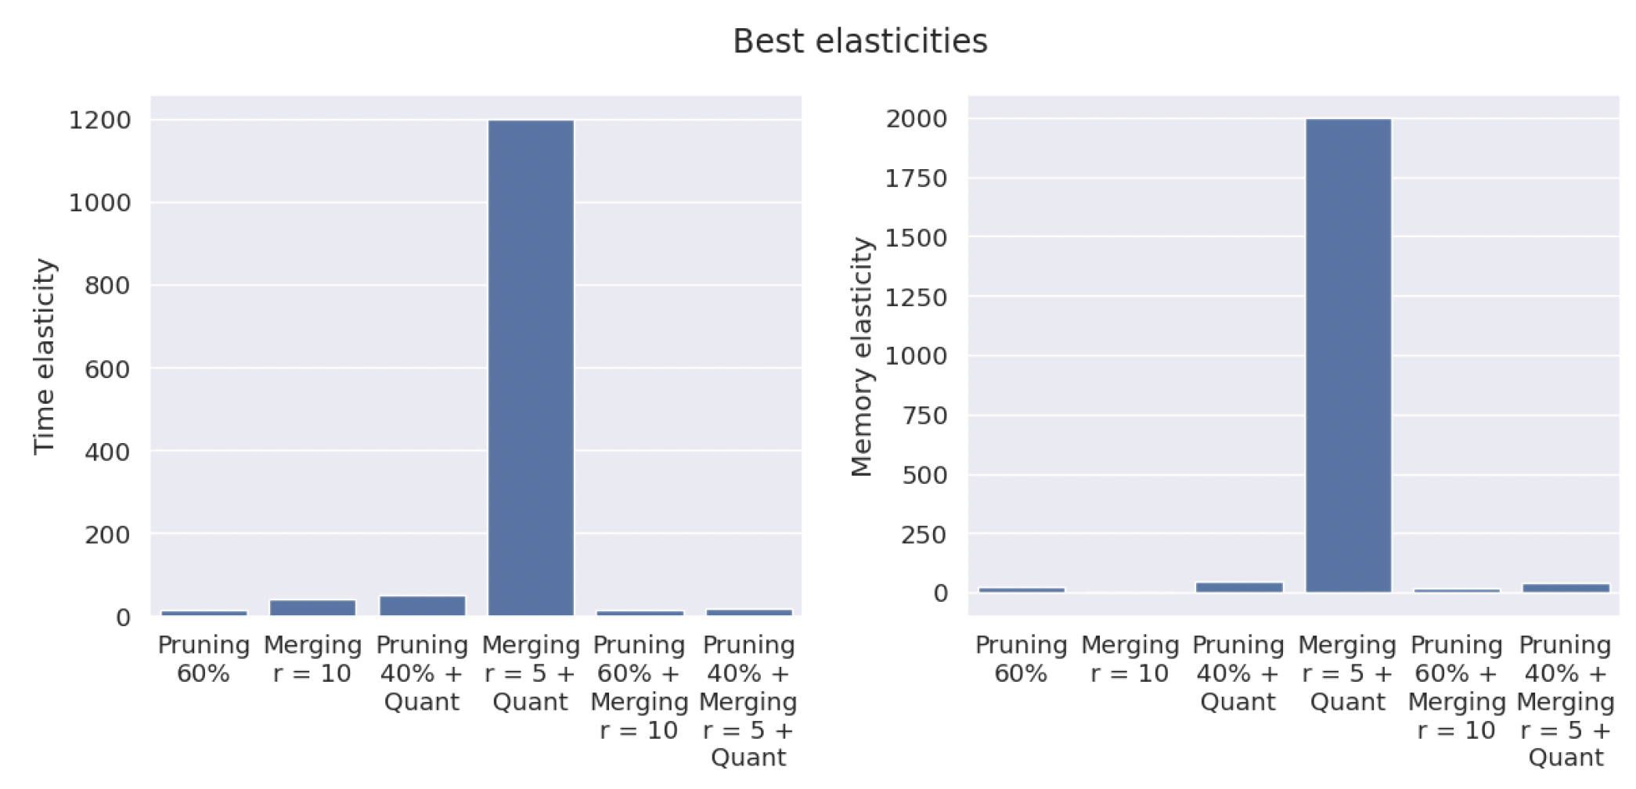
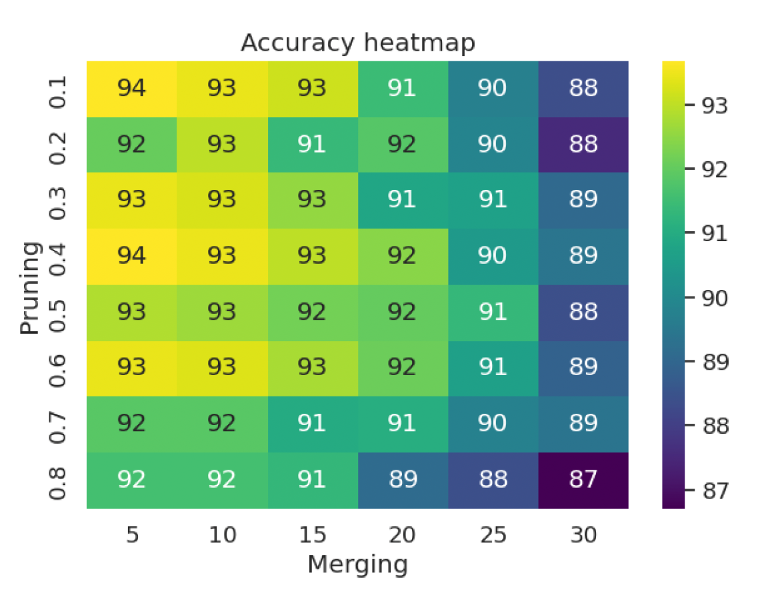
Efficient Vision Transformer Inference on Edge Devices
ViT + Quantization, knowledge distillation, token merging, and pruning
Individual techniques and their combinations
latency-accuracy and memory-accuracy trade-offs
Pruning + Merging + Quantization
[10] Aleix Armero, Efficient Vision Transformer Inference on Edge Devices. Technical report. 2025

Slide 12


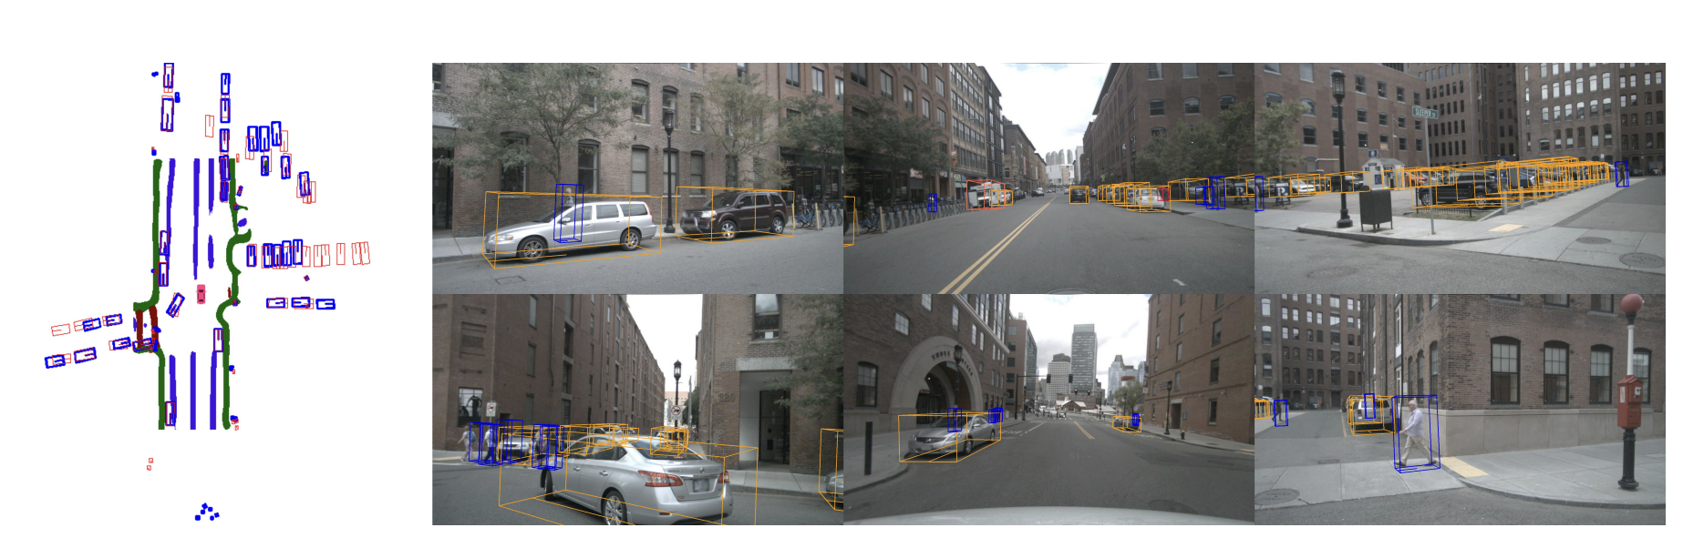
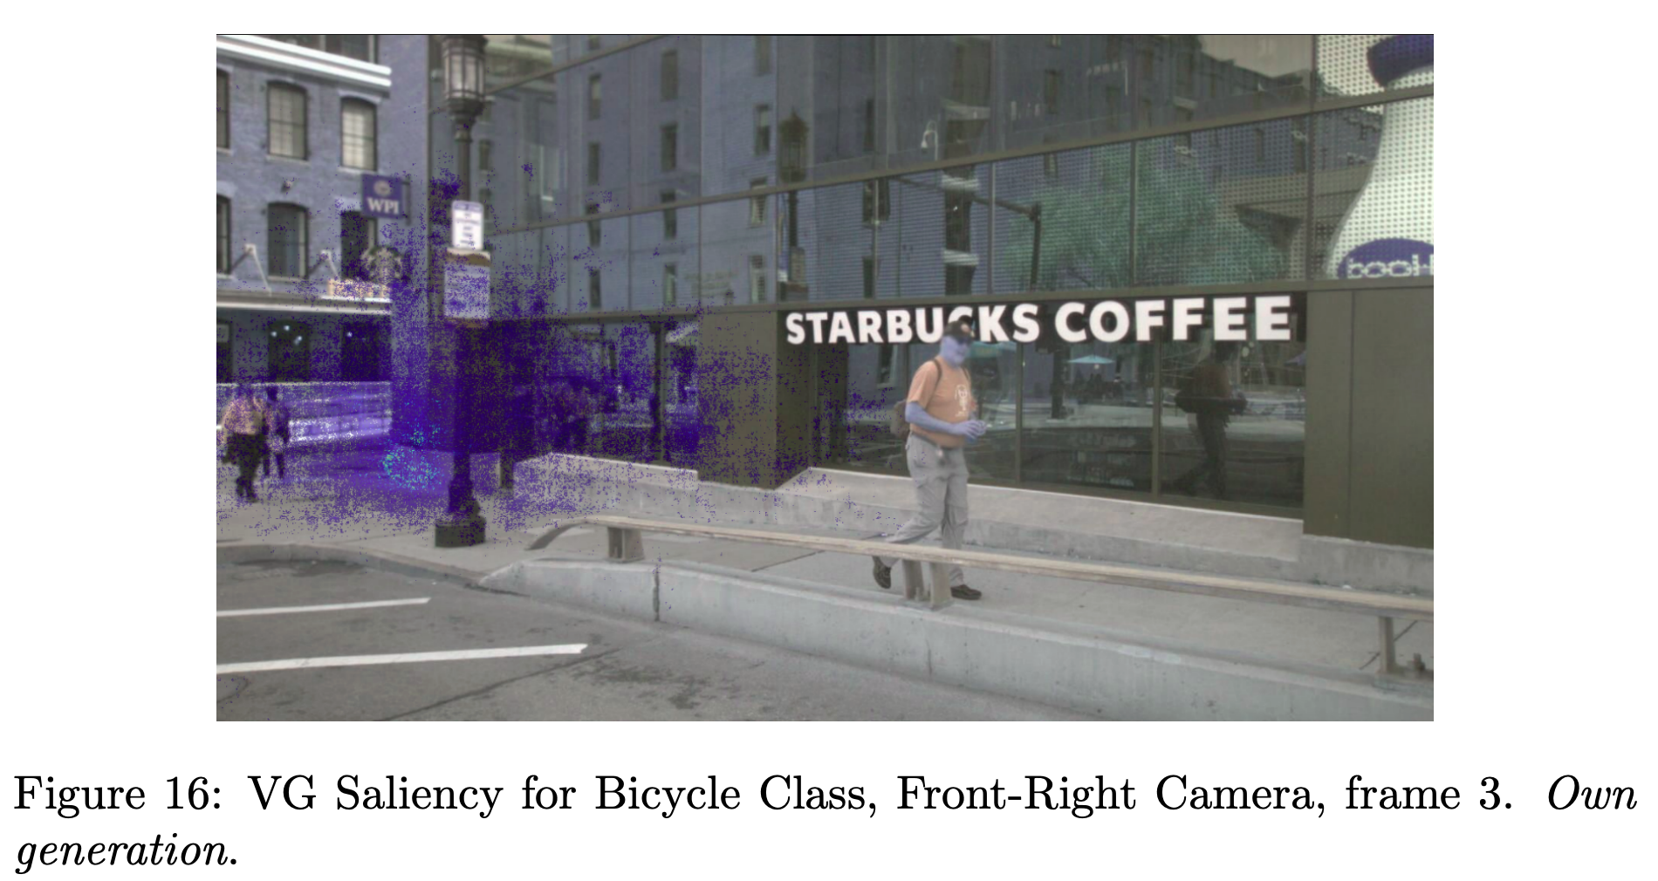
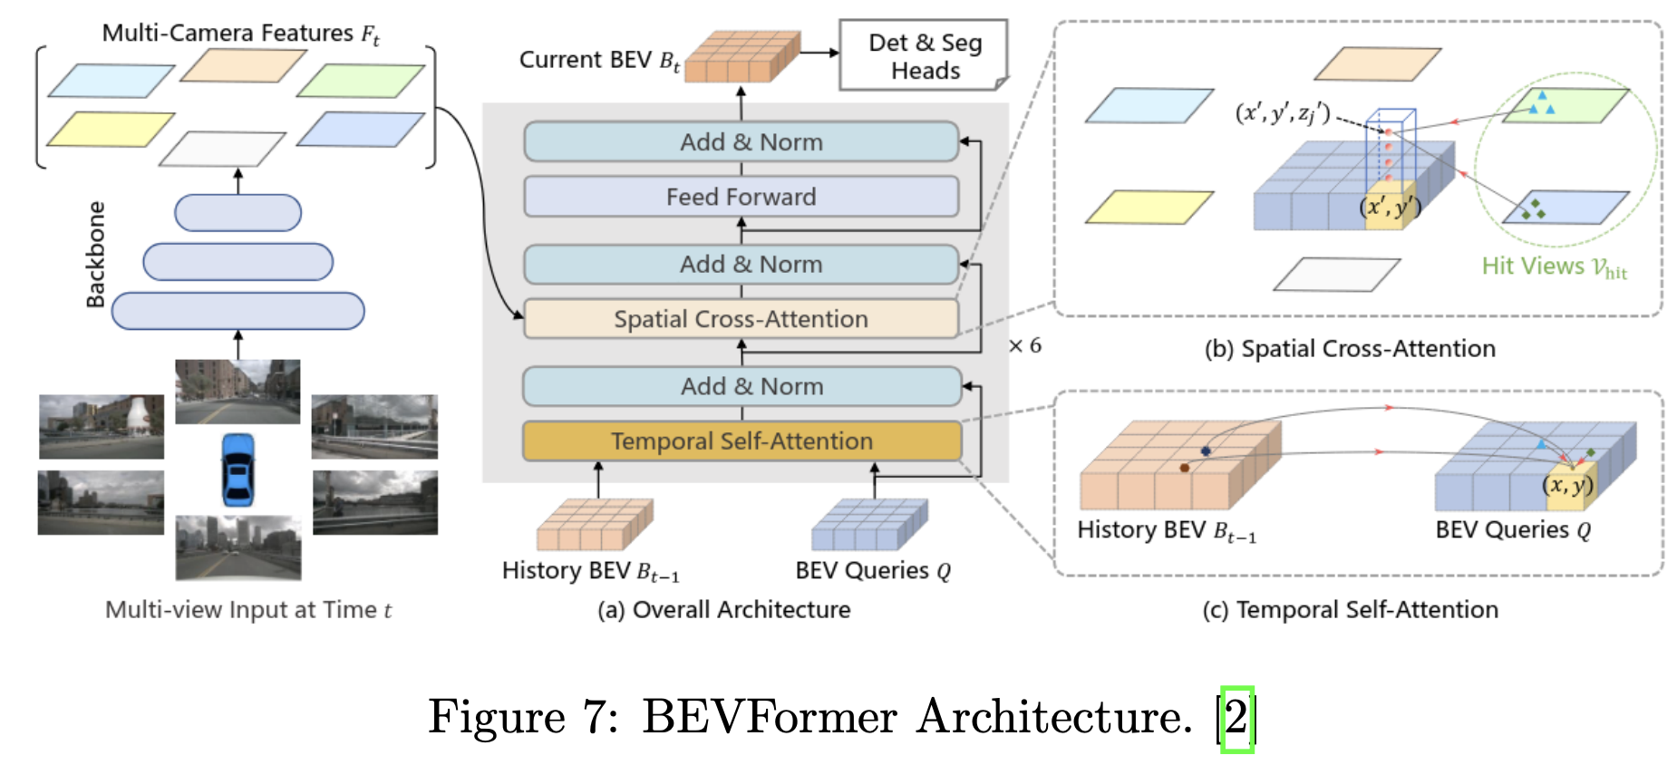
Interpretability Techniques in BEV Autonomous Driving Models
in colaboration with
ViT, 6 cameras, time, 3D detection+segmentation
Vanilla gradients and integrated gradients
Differentiable NDS
Perturbation tests
[11] Adria Ruiz, Ruben Tous and Josep Ramon Casas. Interpretability Techniques in BEV Autonomous Driving Models. 2025 (to be submitted)

Slide 13
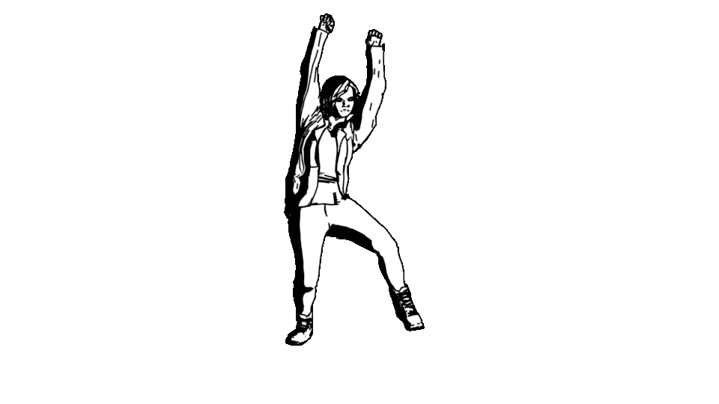
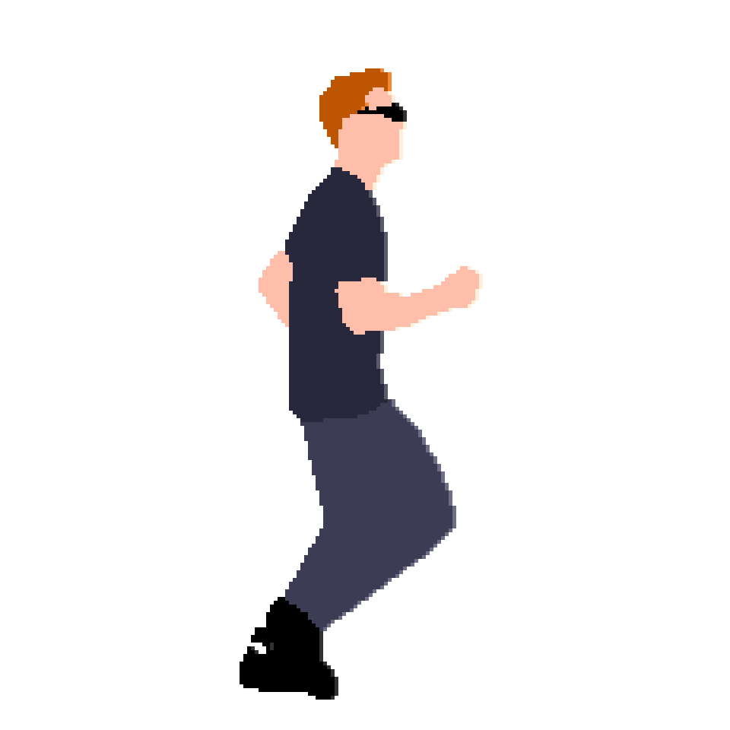
BIMAI Barcelona Image and Artificial Intelligence Lab
https://bimailab.github.io/
CONTRIBUTORS:
Ruben Tous
Beatriz Otero
Aleix Armero
Adrià Ruiz
Eduardo Cid
Rosa Ceano
Maria Bertolin
Judith Caldés
Albert Ruiz
Gustavo Rayo
Camila Pérez
Héctor Antona
Joffre Alcivar
Roger García-Alzórriz
Silvia Arellano
Carlos Valverde
Beatriz Gomes
Roc Masana
Sergi Espinosa
Sebastià Nicolau
CROMAI
Computational Resources Orchestration
and Management for AI

